Slide 1


REST Services and AJAX
HTTP, RESTful Web Services, AJAX Concepts, XMLHttpRequest
SoftUni Team
Technical Trainers
Software University
http://softuni.bg

Slide 2
Table of Contents
The HTTP Overview
HTTP Developer Tools
REST and RESTful Services
Accessing the GitHub API
AJAX
Fetch API

Slide 3
Have a Question?
sli.do #js-advanced

Slide 4

HTTP Overview
HTTP Protocol

Slide 5



HTTP Basics
HTTP (Hyper Text Transfer Protocol)
Text-based client-server protocol for the Internet
For transferring Web resources (HTML files, images, styles, etc.)
Request-response based
HTTP request
HTTP response
Web Client
Web Server

Slide 6






HTTP Request Methods
HTTP defines methods to indicate the desired action to be performed on the identified resource
Method | Description
GET | Retrieve / load a resource
POST | Create / store a resource
PUT | Update a resource
DELETE | Delete (remove) a resource
PATCH | Update resource partially
HEAD | Retrieve the resource's headers
OPTIONS | Returns the HTTP methods that the server supports for the specified URL

Slide 7
HTTP GET Request - Example
GET /users/testnakov/repos HTTP/1.1
Host: api.github.com
Accept: */*
Accept-Language: en
Accept-Encoding: gzip, deflate
User-Agent: Mozilla/5.0 (Windows NT 10.0; WOW64) AppleWebKit/537.36 (KHTML, like Gecko) Chrome/54.0.2840.71 Safari/537.36
Connection: Keep-Alive
Cache-Control: no-cache
<CRLF>
HTTP request line
HTTP headers
The request body is empty

Slide 8
HTTP POST Request - Example
POST /repos/testnakov/test-nakov-repo/issues HTTP/1.1
Host: api.github.com
Accept: */*
Accept-Language: en
Accept-Encoding: gzip, deflate
User-Agent: Mozilla/4.0 (compatible;MSIE 6.0; Windows NT 5.0)
Connection: Keep-Alive
Cache-Control: no-cache
<CRLF>
{"title":"Found a bug",
"body":"I'm having a problem with this.",
"labels":["bug","minor"]}
<CRLF>
HTTP request line
HTTP headers
The request body holds the submitted data

Slide 9
HTTP Response - Example
HTTP/1.1 200 OK
Date: Fri, 11 Nov 2016 16:09:18 GMT+2
Server: Apache/2.2.14 (Linux)
Accept-Ranges: bytes
Content-Length: 84
Content-Type: text/html
<CRLF>
<html>
<head><title>Test</title></head>
<body>Test HTML page.</body>
</html>
HTTP response status line
HTTP response headers
HTTP response body

Slide 10
HTTP Response Status Codes
Status Code | Action | Description
200 | OK | Successfully retrieved resource
201 | Created | A new resource was created
204 | No Content | Request has nothing to return
301 / 302 | Moved | Moved to another location (redirect)
400 | Bad Request | Invalid request / syntax error
401 / 403 | Unauthorized | Authentication failed / Access denied
404 | Not Found | Invalid resource
409 | Conflict | Conflict was detected, e.g. duplicated email
500 / 503 | Server Error | Internal server error / Service unavailable

Slide 11
Content-Type and Disposition
The Content-Type / Content-Disposition headers specify how the HTTP request / response body should be processed
JSON-encoded data
Content-Type: application/json
UTF-8 encoded HTML page. Will be shown in the browser
Content-Type: text/html; charset=utf-8
Content-Type: application/pdf
Content-Disposition: attachment; filename="Financial-Report-April-2016.pdf"
This will download a PDF file named Financial-Report-April-2016.pdf

Slide 12

HTTP Developer Tools
Chrome Dev Tools, Fiddler, Postman

Slide 13
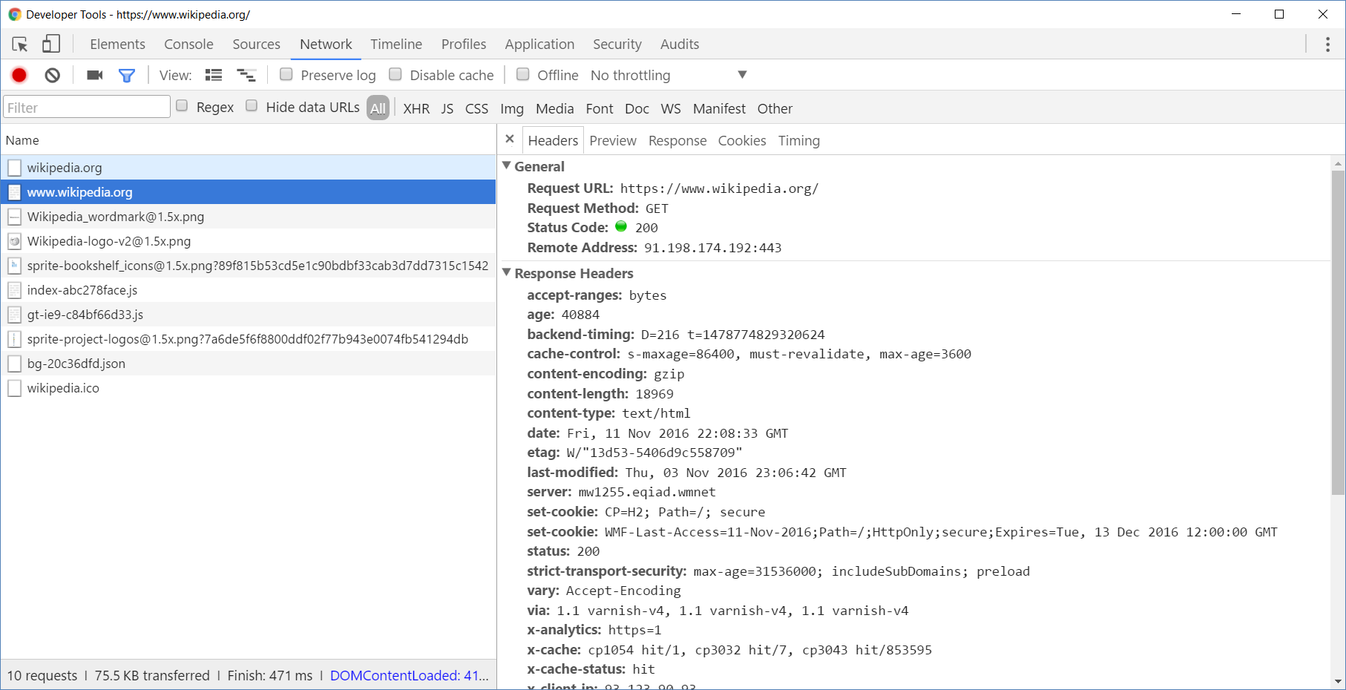
Chrome Developer Tools
Read more about Chrome Developer Tools

Slide 14
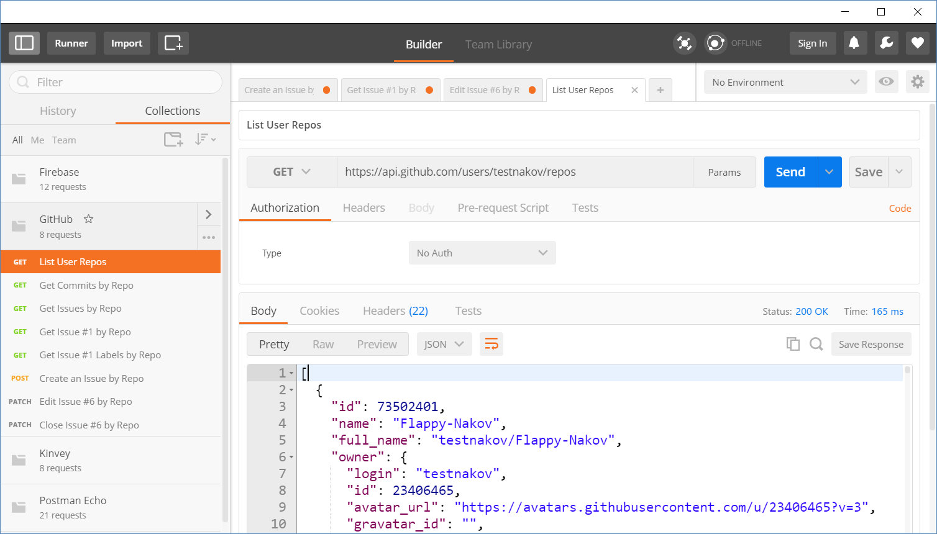
Postman
Read more about Postman REST Client

Slide 15
{REST}
REST and RESTful Services

Slide 16
REST and RESTful Services
Representational State Transfer (REST)
Architecture for client-server communication over HTTP
Resources have URI (address)
Can be created/retrieved/ modified/deleted/etc.
RESTful API/RESTful Service
Provides access to server-side resources via HTTP and REST
REST Web Service
URI
Resource
Representation 1
Representation 2
Representation 3
Representation 4
GET
PUT
POST
DELETE
Uniform Method

Slide 17

REST Architectural Constraints
REST defines 6 architectural constraints which make any web service - a true RESTful API
Client-server architecture
Statelessness
Cacheable
Layered system
Code on demand (optional)
Uniform interface
Read more about REST Architectural Constraints

Slide 18
REST and RESTful Services - Example
Create a new post
Get all posts / specific post
Delete existing post
Replace / modify existing post
POST
http://some-service.org/api/posts
GET
http://some-service.org/api/posts
GET
http://some-service.org/api/posts/17
DELETE
http://some-service.org/api/posts/17
PUT/PATCH
http://some-service.org/api/posts/17

Slide 19

GitHub REST API
Accessing GitHub through HTTP

Slide 20
GitHub API
List user's all public repositories:
Get all commits from a public repository:
Get all issues/issue #1 from a public repository
GET
https://api.github.com/users/testnakov/repos
GET
https://api.github.com/repos/testnakov/softuniada-2016/commits
GET
/repos/testnakov/test-nakov-repo/issues
GET
/repos/testnakov/test-nakov-repo/issues/1

Slide 21

Github: Labels Issue
Get the first issue from the "test-nakov-repo" repository
Send a GET request to:
https://api.github.com/repos/testnakov/test-nakov-repo/ issues/:id
Where :id is the current issue

Slide 22
GitHub API (2)
Get all labels for certain issue from a public repository:
Create a new issue to certain repository (with authentication)
GET
https://api.github.com/repos/testnakov/test-nakov-repo/issues/1/labels
POST
https://api.github.com/repos/testnakov/test-nakov-repo/issues
Headers
Authorization: Basic base64(user:pass)
Body
{"title":"Found a bug",
"body": "I'm having a problem with this."}

Slide 23
Github: Create Issue
Create an issue when you send a "POST" request
Use your Github account credentials to submit the issue

Slide 24

A AX
AJAX
Asynchronous JavaScript and XML

Slide 25
What is AJAX?
Asynchronous JavaScript And XML
Background loading of dynamic content/data
Load data from the Web server and render it
Two types of AJAX
Partial page rendering
Load HTML fragment + show it in a <div>
JSON service
Loads JSON object and displays it

Slide 26

AJAX: Workflow
1. HTTP request (initial page load)
2. HTTP response (HTML page)
AJAX request
UI Interaction
AJAX response (asynchronous)
AJAX handler
Returns data as JSON / HTML
Web Client
Web Server
Modify the page DOM

Slide 27
AJAX request
AJAX response
Web Client
Web Server
Using the XMLHttpRequest Object

Slide 28
XMLHttpRequest - Standard API for AJAX
<button id = "load">Load Repos</button>
<div id="res"></div>
let button = document.querySelector("#load");
button.addEventListener('click', function loadRepos() {
let url = 'https://api.github.com/users/testnakov/repos';
const httpRequest = new XMLHttpRequest();
httpRequest.addEventListener('readystatechange', function () {
if (httpRequest.readyState == 4 && httpRequest.status == 200) {
document.getElementById("res").textContent = httpRequest.responseText;
}
});
httpRequest.open("GET", url);
httpRequest.send();
});
Notes:
Check this slides code -> I think it can be optimized

Slide 29
What is Fetch?
The fetch() method allows making network requests
It is similar to XMLHttpRequest (XHR). The main difference is that the Fetch API:
Uses Promises
Enables a simpler and cleaner API
Makes code more readable and maintainable
fetch('./api/some.json')
.then(function(response) {…})
.catch(function(err) {…})

Slide 30
Basic Fetch Request
The response of a fetch() request is a Stream object
The reading of the stream happens asynchronously
When the json() method is called, a Promise is returned
The response status is checked (should be 200) before parsing the response as JSON
if (response.status !== 200) {
// handle error
}
response.json()
.then(function(data) { console.log(data)})

Slide 31
Chaining Promises
When working with a JSON API, you can:
Define the status and JSON parsing in separate functions
The functions return promises which can be chained
fetch('users.json')
.then(status)
.then(json)
.then(function(data) {…})
.catch(function(error) {…});

Slide 32
GET Request
Fetch API uses the GET method so that a direct call would be like this
fetch('https://swapi.co/api/people/4')
.then((response) => response.json())
.then((data) => console.log(JSON.stringify(data)))
.catch((error) => console.error(error))

Slide 33
POST Request
To make a POST request, we can set the method and body parameters in the fetch() options
fetch('/url', {
method: 'post',
headers: { 'Content-type': 'application/json' },
body: JSON.stringify(data),
})

Slide 34
Body Methods
clone() - create a clone of the response
json() - resolves the promise with JSON
redirect() - create new promise but with different URL
text() - resolves the promise with string

Slide 35
Response Types
basic - normal, same origin response
cors - response was received from a valid cross-origin request
error - error network
opaque - Response for "no-cors" request to cross-origin resource

Slide 36
Body Methods (2)
opaqueredirect - the fetch request was made with redirect: "manual"
arrayBuffer() - return a promise that resolve with an ArrayBuffer
blob() - determinates with a Blob
formData() - return promise that determinate with FormData object

Slide 37

Live Exercises

Slide 38
Summary
…
…
…
HTTP is text-based request-response protocol
REST uses GET, POST, PUT, PATCH, DELETE
RESTful services address resources by URL
Provide CRUD operations over HTTP
AJAX background loading of dynamic content
XMLHttpRequest
Fetch

Slide 39
https://softuni.bg/courses/js-applications

Slide 40












SoftUni Diamond Partners

Slide 41




SoftUni Organizational Partners

Slide 42




Trainings @ Software University (SoftUni)
Software University – High-Quality Education and Employment Opportunities
softuni.bg
Software University Foundation
http://softuni.foundation/
Software University @ Facebook
facebook.com/SoftwareUniversity
Software University Forums
forum.softuni.bg

Slide 43

License
This course (slides, examples, demos, videos, homework, etc.) is licensed under the "Creative Commons Attribution-NonCommercial-ShareAlike 4.0 International" license

